Slide 1
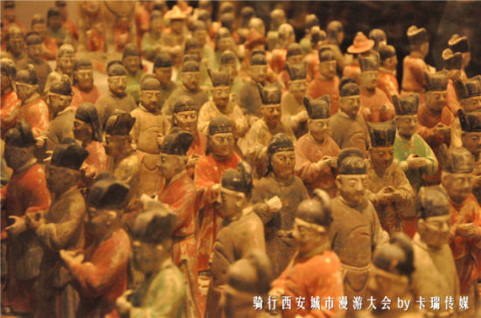
The China Biographical Database (CBDB) for Network Analysis
Singapore,
August 4, 2018
Song Chen 陳松, Bucknell University http://bucknell.academia.edu/songchen

Slide 2
The China Biographical Database (CBDB) 中國歷代人物傳記資料庫 (CBDB)
Contents and Data Structure 內容與數據結構

Slide 3
A Subset of the Data on Sima Guang:
有關司馬光的部分數據：
Name 姓名 | Dates 日期 | Offices 任官 | Associations 社會關係
Sima Guang 司馬光 | 1019-1086 | (1) 1059 度支勾院 Budget Auditor; (2) 1085 門下侍郎 Executive of the Chancellery; (3) 1086 左僕射兼門下侍郎 Left Executive, Dept of Ministries [….] | (1) Yuanyou coalition member (元祐黨); (2) An Dun 安惇 Desires opposed by; (3) Chao Buzhi 晁補之 Sacrificial prayer written by; (4) Chen Jian 陳薦 Sacrificial prayer written for; (5) Chen Min 陳敏 Honored by; (6) Cheng Yi 程頤 Recommended; (7) Ding Du 丁度 Sacrificial prayer written for; (8) Fan Chunli 范純禮 Patron of; [….]

Slide 4
Reorganizing the Data on Sima Guang (First Version):
重新編排有關司馬光的數據（第一版）：
Name 人物 | Dates 日期
Sima Guang 司馬光 | 1019-1086
Person 人物 | Posting Date 任命日期 | Office Title 官名
Sima Guang 司馬光 | 1059 | 度支勾院 Budget Auditor
Sima Guang 司馬光 | 1085 | 門下侍郎 Executive of the Chancellery
Sima Guang 司馬光 | 1086 | 左僕射兼門下侍郎 Left Executive, Dept of Ministries
Person 人物 | Association Type 社會關係 | Associate 社會關係人
Sima Guang 司馬光 | Yuanyou member (元祐黨) | (not applicable)
Sima Guang 司馬光 | Desires opposed by | An Dun 安惇
Sima Guang 司馬光 | Sacrificial prayer written by | Chao Buzhi 晁補之
Sima Guang 司馬光 | Patron of | Fan Chunli 范純禮
Sima Guang 司馬光 | Sacrificial prayer written for | Ding Du 丁度

Slide 5
One can now sort on the separate columns:
現在我們可以按照不同欄位分別排序：
Name 姓名 | Dates 日期
Sima Guang 司馬光 | 1019-1086
Person 人物 | Posting Date 任命日期 | Office Title 官名
Sima Guang 司馬光 | 1059 | 度支勾院 Budget Auditor
Sima Guang 司馬光 | 1085 | 門下侍郎 Executive of the Chancellery
Sima Guang 司馬光 | 1086 | 左僕射兼門下侍郎 Left Executive, Dept of Ministries
Person 人物 | Association Type 社會關係 | Associate 社會關係人
Sima Guang 司馬光 | Yuanyou member (元祐黨) | (not applicable)
Sima Guang 司馬光 | Desires opposed by | An Dun 安惇
Sima Guang 司馬光 | Sacrificial prayer written by | Chao Buzhi 晁補之
Sima Guang 司馬光 | Patron of | Fan Chunli 范純禮
Sima Guang 司馬光 | Sacrificial prayer written for | Ding Du 丁度

Slide 6
Relational Database:
關係型數據庫
Many Entities 多個實體 People 人物
Offices 職官
Association Types 社會關係
Name 姓名 | Dates 日期
Sima Guang 司馬光 | 1019-1086
Person 人物 | Posting Date 任命日期 | Office Title 官名
Sima Guang 司馬光 | 1059 | 度支勾院 Budget Auditor
Sima Guang 司馬光 | 1085 | 門下侍郎 Executive of the Chancellery
Sima Guang 司馬光 | 1086 | 左僕射兼門下侍郎 Left Executive, Dept of Ministries
Person 人物 | Association Type 社會關係 | Associate 社會關係人
Sima Guang 司馬光 | Yuanyou member (元祐黨) | (not applicable)
Sima Guang 司馬光 | Desires opposed by | An Dun 安惇
Sima Guang 司馬光 | Sacrificial prayer written by | Chao Buzhi 晁補之
Sima Guang 司馬光 | Patron of | Fan Chunli 范純禮
Sima Guang 司馬光 | Sacrificial prayer written for | Ding Du 丁度
Notes:
6

Slide 7
CBDB as a Relational Database: Many Different Entities:
作為關係型數據庫的CBDB
多個不同實體
People (name, birth/death dates, etc.)
Associations
Offices (name, begin/end dates, rank, etc.)
Places (name, location, jurisdiction type, etc.)
Texts (author, title, genre, etc.)
Kinship
Social Status (merchant, doctor, etc.)
Possessions
Events (?)
人物 (姓名、出生年月等)
社會關係
職官(官名、起止年月、品級等)
地址 (地名、方位、行政類別等)
著作 (作者、書名、部類等)
親屬關係
社會區分 (商人或醫生等)
財產
事件(?)

Slide 8
Entity Relations Modeling: Abstracting the features of the Biographical World 實體關係建模： 將傳記資料的特徵抽象化
Association Types社會關係
Person人物
Place地址
Offices職官
is an
是一種
has an
擁有
has a
擁有
is at
位於
is a
是一種
Association 社會關係資料
Postings 任官資料

Slide 9
Removing Duplication in the Data on Entities
刪除數據中有關各個實體的重複信息
ID | Name 姓名 | Dates 日期
1 | Sima Guang 司馬光 | 1019-1086
Postings Data 任官資料
Person 人物 | Posting Date 任命日期 | Office Title 官名
Sima Guang 司馬光 | 1059 | 度支勾院 Budget Auditor
Sima Guang 司馬光 | 1085 | 門下侍郎 Executive of the Chancellery
Sima Guang 司馬光 | 1086 | 左僕射兼門下侍郎 Left Executive, Dept of Ministries
Associations Data 社會關係資料
Person 人物 | Association Type 社會關係 | Associate 社會關係人
Sima Guang 司馬光 | Yuanyou member (元祐黨) | (not applicable)
Sima Guang 司馬光 | Desires opposed by | An Dun 安惇
Sima Guang 司馬光 | Sacrificial prayer written for | Chen Jian(5) 陳薦
Sima Guang 司馬光 | Patron of | Fan Chunli 范純禮
Sima Guang 司馬光 | Sacrificial prayer written for | Ding Du 丁度

Slide 10
Reorganizing the Data (2nd Version):
重新編排數據（第二版）
Office Titles 官名
Postings Data
任官資料
ID | Office Name
1 | 度支勾院 Budget Auditor
2 | 門下侍郎 Executive of the Chancellery
3 | 左僕射兼門下侍郎 Left Executive, Dept of Ministries
People 人物
Person ID | Office ID | Posting Date
1 | 1 | 1059
1 | 2 | 1085
1 | 3 | 1086
ID | Name | Dates
1 | Sima Guang 司馬光 | 1019-1086
2 | An Dun 安惇 | 10
3 | Chao Buzhi 晁補之
4 | Chen Jian(5) 陳薦
5 | Chen Min 陳敏
6 | Cheng Yi 程頤
7 | Ding Du 丁度
8 | Fan Chunli 范純禮
Associations Data
社會關係資料
Associations 社會關係
ID | Association Type
1 | Yuanyou coalition member (元祐黨)
2 | Desires opposed by
3 | Sacrificial prayer written by
4 | Sacrificial prayer written for
5 | Honored by
6 | Recommended
7 | Patron of
Assoc Type ID | Person ID | Assoc ID
1 | 1 | -1
2 | 1 | 2
3 | 1 | 3
4 | 1 | 4
5 | 1 | 5
6 | 1 | 6
4 | 1 | 7
7 | 1 | 8
Notes:
10

Slide 11
Second Advantage of Relational Databases: “Data Normalization”
關係型數據庫之優點（二）：「數據規範化 」
Information about entities appears just once in the database.
Errors in information need to be corrected just once.
New information uses “table-look-up” about entities that reduces data-entry mistakes.
各個實體的信息在數據庫中僅出現一次。
對出錯的信息加以糾正時，只需糾正一次。
新增信息時，會查詢資料表添加有關各個實體的信息，故而減少了數據錄入時的出錯幾率。

Slide 12
Second Advantage of Relational Databases: “Data Normalization”
關係型數據庫之優點（二）：「數據規範化 」
People are entities.
Their names are information about them. Misromanization (岑參 as “Cen Can”) needs to be corrected in just one place.
Inputters need not know how to romanize 岑參 since they will get his ID from the “PEOPLE” table.
每個人物都是一個實體。
其姓名則是有關這個實體的信息。
因此，當一個人物的姓名的拼音出現錯誤時（如將「岑參 」 的拼音誤作 “Cen Can”），只需在一處加以修改即可。
輸入者無需知道「岑參 」的拼音為何，因為他們將從人物資料表中抓取他的ID編號。

Slide 13
PEOPLE TABLE
人物資料表
Person ID
Name
姓名
Born
Died
Choronym ID
Dynasty ID, etc
OFFICE TABLE
官名代碼表
Office ID
Office Name
官名
Office Type ID
POSTINGS TABLE
任官資料表
Person ID
Office ID
Address ID
Start Date
End Date
Post Type ID
ADDRESS TABLE
地名代碼表
Address ID
Place Name
地名
Admin Unit ID, etc.
BIOGRAPHY ADDRESS TABLE
地址資料表
Person ID
Address ID
Address Type ID
Start Date
End Date
Linked Tables Based on the Entity-Relations Model
基於實體關係模型建立起的相互關聯的資料表

Slide 14
Sima(1) Guang 司馬光. 1019-1086.
Offices 1059 度支勾院 Budget Auditor 1085 門下侍郎 Executive of the Chancellery 1086 左僕射兼門下侍郎 Left Executive, Dept of Ministries
Employment 1 office: finance 2 office: state council
Entry 入法: 蔭yin 進士 jinshi
Places Basic Affiliation Yongxing 永興, Shan 陝, Xia Xian 夏縣 0-0
Alternate Names Junshi 君實 Capping Name Wenzheng Gong 文正公 Posthumous Name Sushui Xiansheng 涑水先生 Other Yufu 迂夫 Style Name Yusou 迂叟 Style Name
Data on people in a relational database is in the interaction between entities (person, place, etc.)在關係型數據庫中，人物的數據資料存在於各種實體（人物、地址等）的互動之中。

Slide 15
Third Advantage: Relational databases greatly facilitate searches in looking at the interaction of entities: 優點（三）：關聯型數據庫極大地方便了對不同實體的交叉檢索
(1) Searching single tables
查詢單張資料表
Sima(1) Guang 司馬光. 1019-1086.
Offices 1059 度支勾院 Budget Auditor 1085 門下侍郎 Executive of the Chancellery 1086 左僕射兼門下侍郎 Left Executive, Dept of Ministries
Employment 1 office: finance 2 office: state council
Entry: yin jinshi
Places Basic Affiliation Yongxing 永興, Shan 陝, Xia Xian 夏縣 0-0
Alternate Names Junshi 君實 Capping Name Wenzheng Gong 文正公 Posthumous Name Sushui Xiansheng 涑水先生 Other Yufu 迂夫 Style Name Yusou 迂叟 Style Name
Looking at data on office holding查看有關任官情況的數據

Slide 16
(1) Biographical data are coded and stored in tables. 傳記資料以代碼的形式存儲於資料表中。
BIOG_MAIN
Biography Addresses
Alternate Names
Writings
Postings
Mode of Entry into Government
Kinship
Associations
Social Status
Possessions
Events
基本資料
地址資料
別名資料
著述資料
任官資料
入仕途徑
親屬資料
社會關係資料
社會區分資料
財產資料
事件資料
Notes:
16

Slide 17
ALT NAMES 別名
Person ID Name Type ID Alt Name, etc
WRITINGS 著述
Person ID Text ID, etc
ENTRY 入仕
Person ID Entry ID Year, etc
BIOG ADDR 地址
Person ID Addr Type ID Place ID, etc
Data tables are linked to each other via Person IDs.
這些資料表通過人物代碼關聯起來。
POSTINGS 任官
Person ID Postings ID Office ID Start Date End Date, etc
BIOG_MAIN 基本資料
Person ID Name 姓名 Born Died Index Year Choronym ID Dynasty ID, Etc
ASSOCIATIONS 社會關係
Person ID Assoc Relation ID Associate ID, etc
POST ADDR 任官地
Postings ID Place ID, etc
KINSHIP 親屬
Person ID Kin Relation ID Kin ID, etc
SOCIAL STATUS 社會區分
Person ID Status ID, etc

Slide 18
(2) Codes are described by other tables. 代碼的內容可以通過其他資料表加以描述。
Each code represents a distinct entity.
The meaning of each code is explained in Chinese and English in code tables.
Each code may be classified under different types (and subtypes).
Supplementary information may be provided for a code in additional tables.
每個代碼代表一個實體。
每個代碼的意涵在代碼表中用中、英文分別予以描述。
每個代碼可以被劃分入不同的類別（以及子類別）。
數據庫還可以通過其他資料表為代碼補充額外的信息。
Notes:
18

Slide 19
BIOG_MAIN 基本資料
Person ID Name 姓名 Born Died Index Year Choronym ID Dynasty ID, Etc
POSTINGS 任官
Person ID Postings ID Office ID Start Date End Date, etc
OFFICE CODES 官名代碼表
Office ID Office Title (Chn) Office Title (Pinyin) Office Title (Eng), etc
OFFICE DATA 官名資料
Office ID Start Date End Date Level Rank Salary, etc
OFFICE TYPES 官名類別
Office Type ID Type Description Type Parent ID Type Level, etc
OFFICE CODE_TYPE REL 官名代碼-類別關係
Office ID Office Type ID, etc

Slide 20
Example: A Subset of Data on Sima Guang
示例：有關司馬光的部分數據
Postings Data
任官資料
Offices 官名
ID | Office Title
1 | 度支勾院 Budget Auditor
2 | 門下侍郎 Executive of the Chancellery
3 | 左僕射兼門下侍郎 Left Executive, Dept of Ministries
People 人物
Person ID | Office ID | Posting Date
1 | 1 | 1059
1 | 2 | 1085
1 | 3 | 1086
ID | Name | Dates
1 | Sima Guang 司馬光 | 1019-1086
2 | An Dun 安惇 | 10
3 | Chao Buzhi 晁補之
4 | Chen Jian(5) 陳薦
5 | Chen Min 陳敏
6 | Cheng Yi 程頤
7 | Ding Du 丁度
8 | Fan Chunli 范純禮
Associations Data
社會關係資料
Associations 社會關係
Person ID | Assoc Type ID | Assoc ID
1 | 1 | -1
1 | 2 | 2
1 | 3 | 3
1 | 4 | 4
1 | 5 | 5
1 | 6 | 6
1 | 4 | 7
1 | 7 | 8
ID | Association Type
1 | Yuanyou coalition member (元祐黨)
2 | Desires opposed by
3 | Sacrificial prayer written by
4 | Sacrificial prayer written for
5 | Honored by
6 | Recommended
7 | Patron of

Slide 21
The “Data Repository” Approach
The subject failed the exams and never entered office. Otherwise, his official career would go here.
Parents, grandparents, great-grandparents
Age of death
Name and alternate name of the subject
daughter and her husband
native place
Site of Burial
Year/month/day of death
Sons, and their degrees and current office titles
legend of family origin

Slide 22
“Factoids” in biographical texts

Slide 23
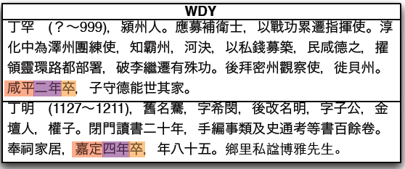
Regular Expressions and Pattern Search
23

Slide 24
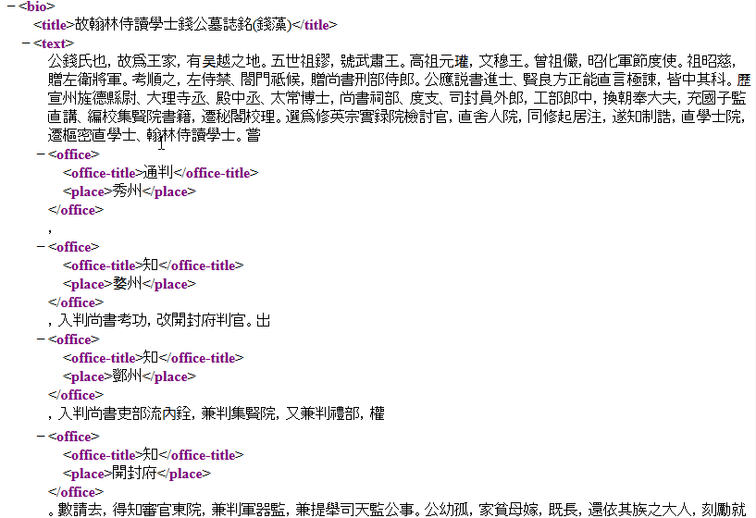
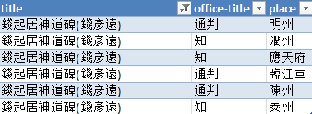
Data Mining and Extraction
Find: (知)(陳留|雍邱|封邱|中牟|…|寧陵)
Replace with: <office><office-title>\1</office-title><place>\2</place></office>

Slide 25
Data Integration and Multi-Point Data Access
BIOG ADDR 地址
Person ID Addr Type ID Place ID, etc
POSTINGS 任官
Person ID Postings ID Office ID Start Date End Date, etc
BIOG_MAIN 基本資料
Person ID Name 姓名 Born Died Index Year Choronym ID Dynasty ID, etc.
POST ADDR 任官地
Postings ID Place ID, etc

Slide 26
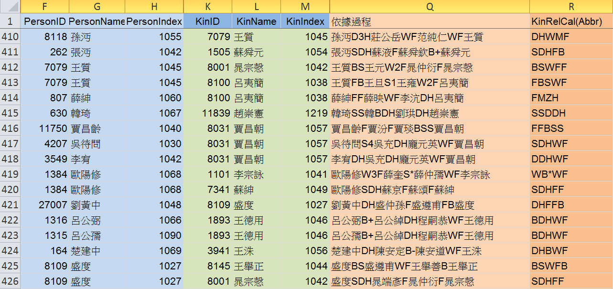
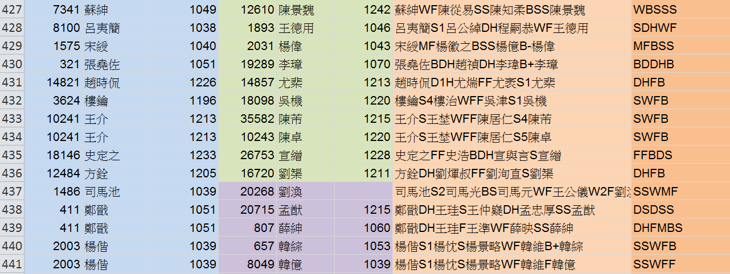
Recursive Queries on Network Data
BIOG_MAIN 基本資料
Person ID Name 姓名 Born Died Index Year Choronym ID Dynasty ID, Etc
KINSHIP 親屬
Person ID Kin Relation ID Kin ID, etc

Slide 27
Network Data Integration
BIOG_MAIN 基本資料
Person ID Name 姓名 Born Died Index Year Choronym ID Dynasty ID, Etc
翰林侍讀學士朝散大夫尚書右司郎中集賢殿修撰中都縣開國伯食邑八百户護軍賜紫金魚袋特贈左諫議大夫呂公墓誌銘
魯國公贈太尉中書令王公行狀
KINSHIP 親屬
Person ID Kin Relation ID Kin ID, etc

Slide 28
Prosopography and Network Analysis
群體傳記學和網絡分析法

Slide 29
Prosopography 群體傳記學
'Prosopography’ is the investigation of the common background characteristics of a group of actors in history by means of a collective study of their lives. The method employed is to establish a universe to be studied, and then to ask a set of uniform questions – about birth and death, marriage and family, social origins and inherited economic position, place of residence, education, amount and source of personal wealth, occupation, religion, experience of office and so on. The various types of information about the individuals in the universe are then juxtaposed and combined, and are examined for significant variables. They are tested both for internal correlations and for correlations with other forms of behaviour or action.
-- L. Stone, ‘Prosopography’, in F. Gilbert and S. Graubard eds., Historical Studies Today (New York, 1972).

Slide 30
群體傳記學 (Prosopography)
「群體傳記學」 為透過對一群人之生平作集體性研究，而對這群歷史人物之共同背景特徵所作的探討。其採用的方法為建立一個研究的場域 (a universe to be studied)，然後詢問一組統一化的問題---關於出生與死亡，婚姻與家庭，社會出身與其繼承的經濟地位，居住地，教育，個人財富之數量與來源，職業，宗教，公職經驗等等。然後將身處此一場域之所有個人的各種類型資訊並列與結合，檢查其重要的變數。研究者測試這些資訊的內在相關性，以及其與其他行為與行動模式的相關性。(L. Stone, 'Prosopography', in F. Gilbert and S. Graubard eds., Historical Studies Today (New York, 1972)

Slide 31
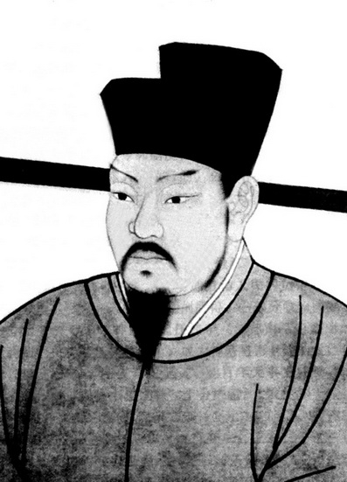
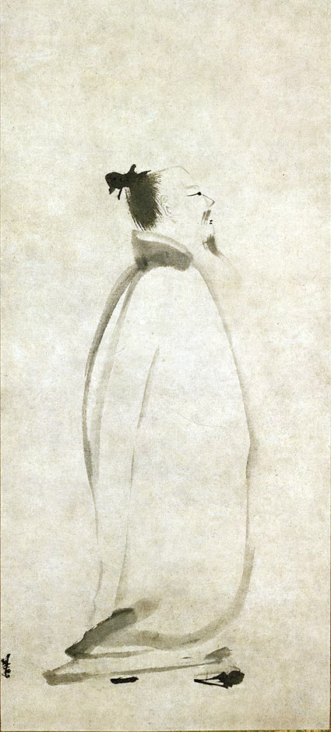
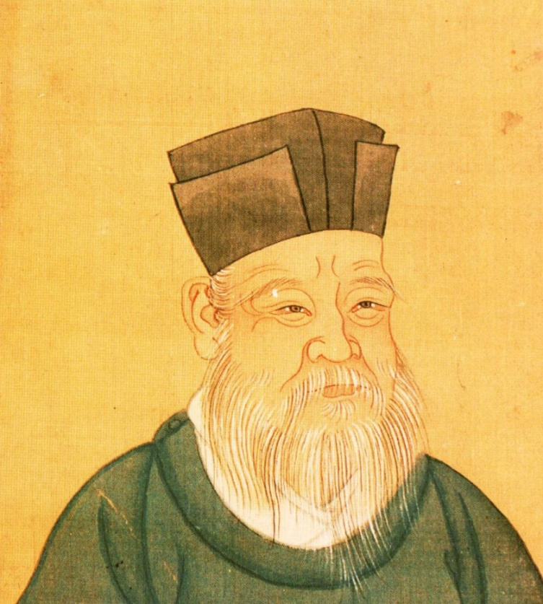
Li Bai 李白
(701-762)
Zhu Xi 朱熹
(1170-1200)
Wang Anshi 王安石
(1021-1086)

Slide 32
PROSOPOGRAPHY

Slide 33
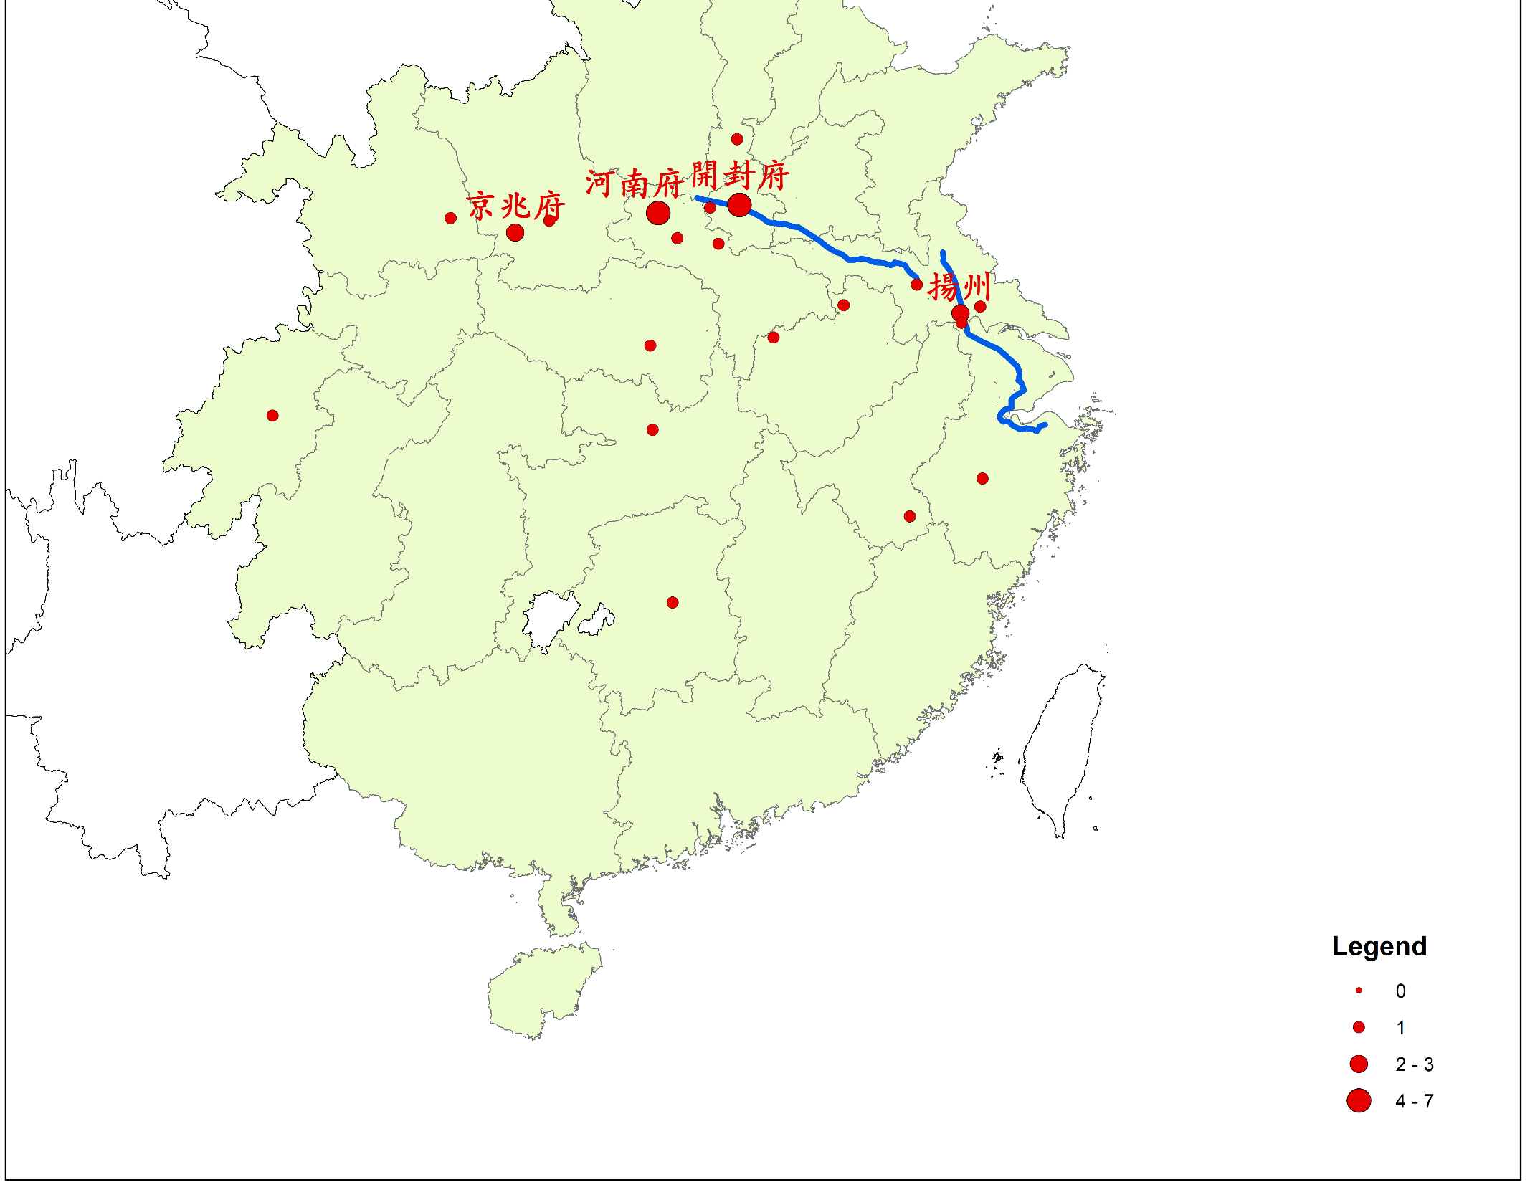
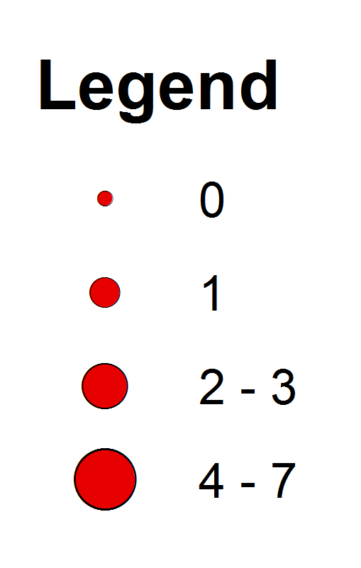
Burial Sites of Sichuanese Official Families,
Established Prior to 1090

Slide 34
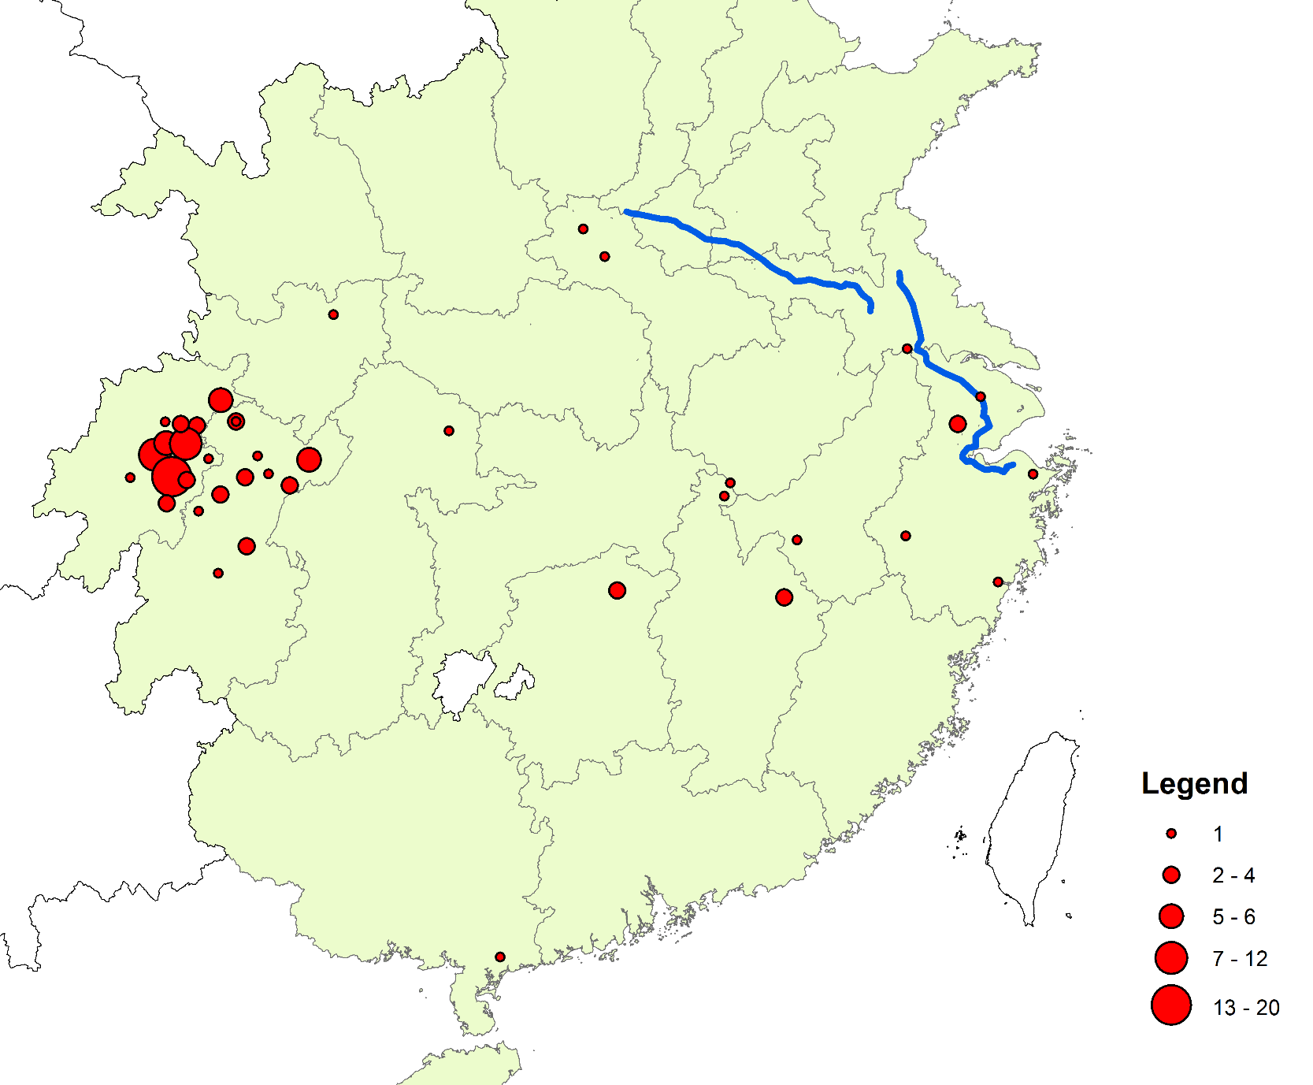
Burial Sites of Sichuanese Official Families,
Established After 1090

Slide 35
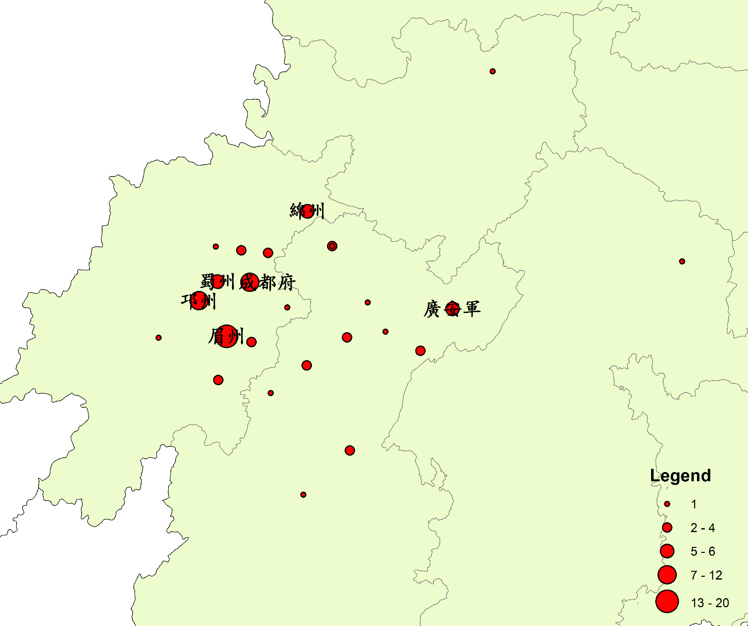
Burial Sites of Sichuanese Official Families,
Established After 1090

Slide 36
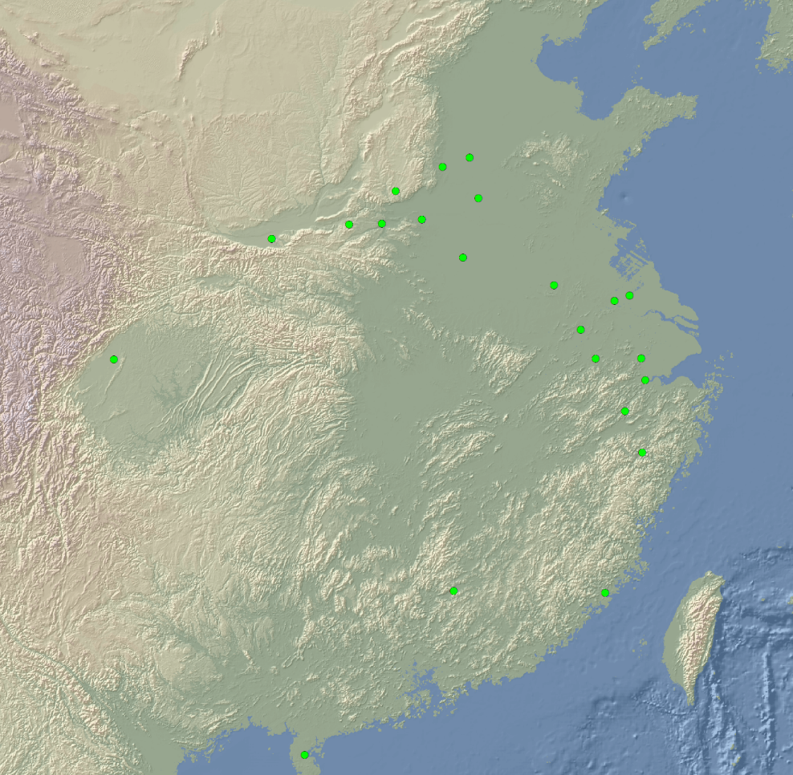
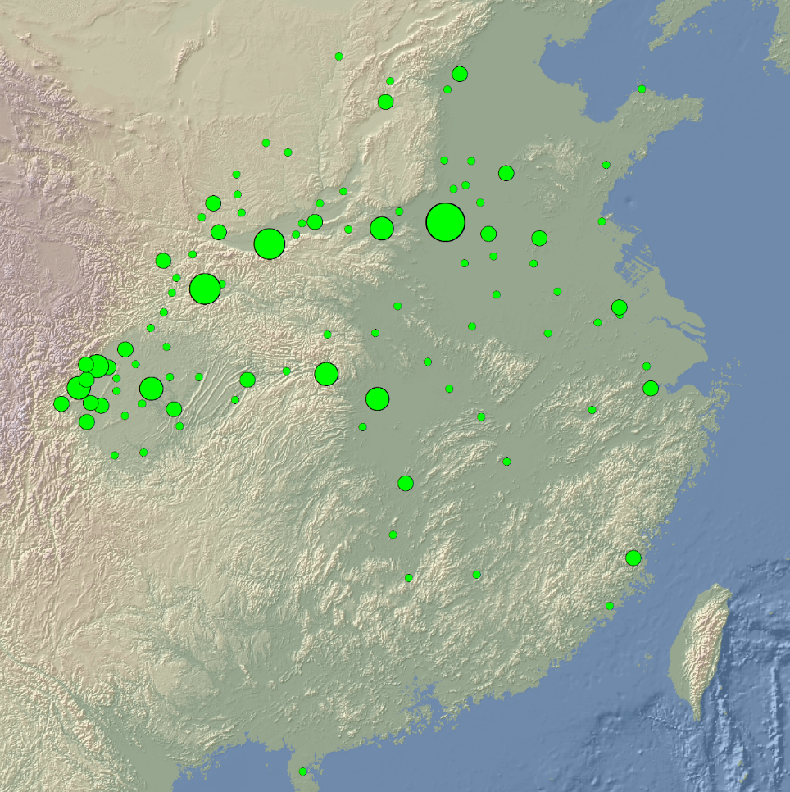
Local Appointments of Sichuan Men, by Year of Entry into Government
965-1019 1020-1059
Notes:
Sichuan Careers

Slide 37
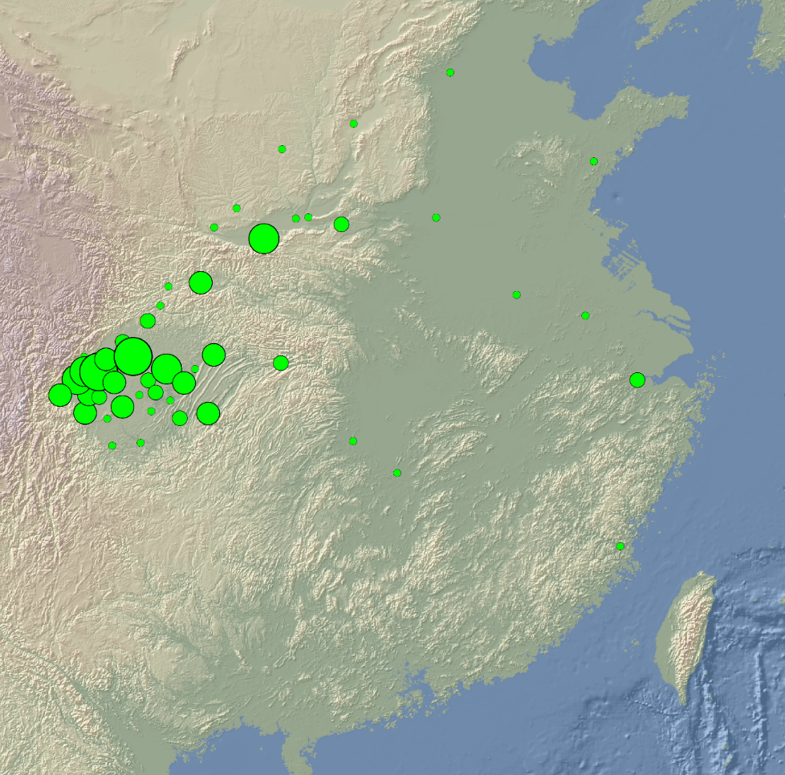
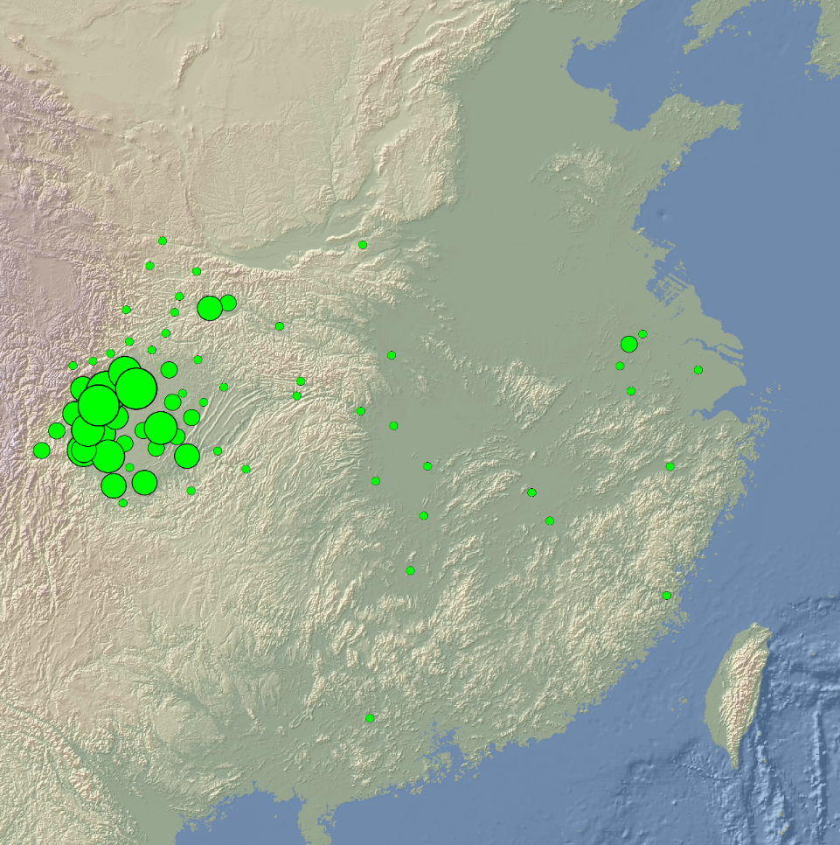
Local Appointments of Sichuan Men, by Year of Entry into Government
1060-1127 1128-1241
Notes:
Sichuan Careers

Slide 38
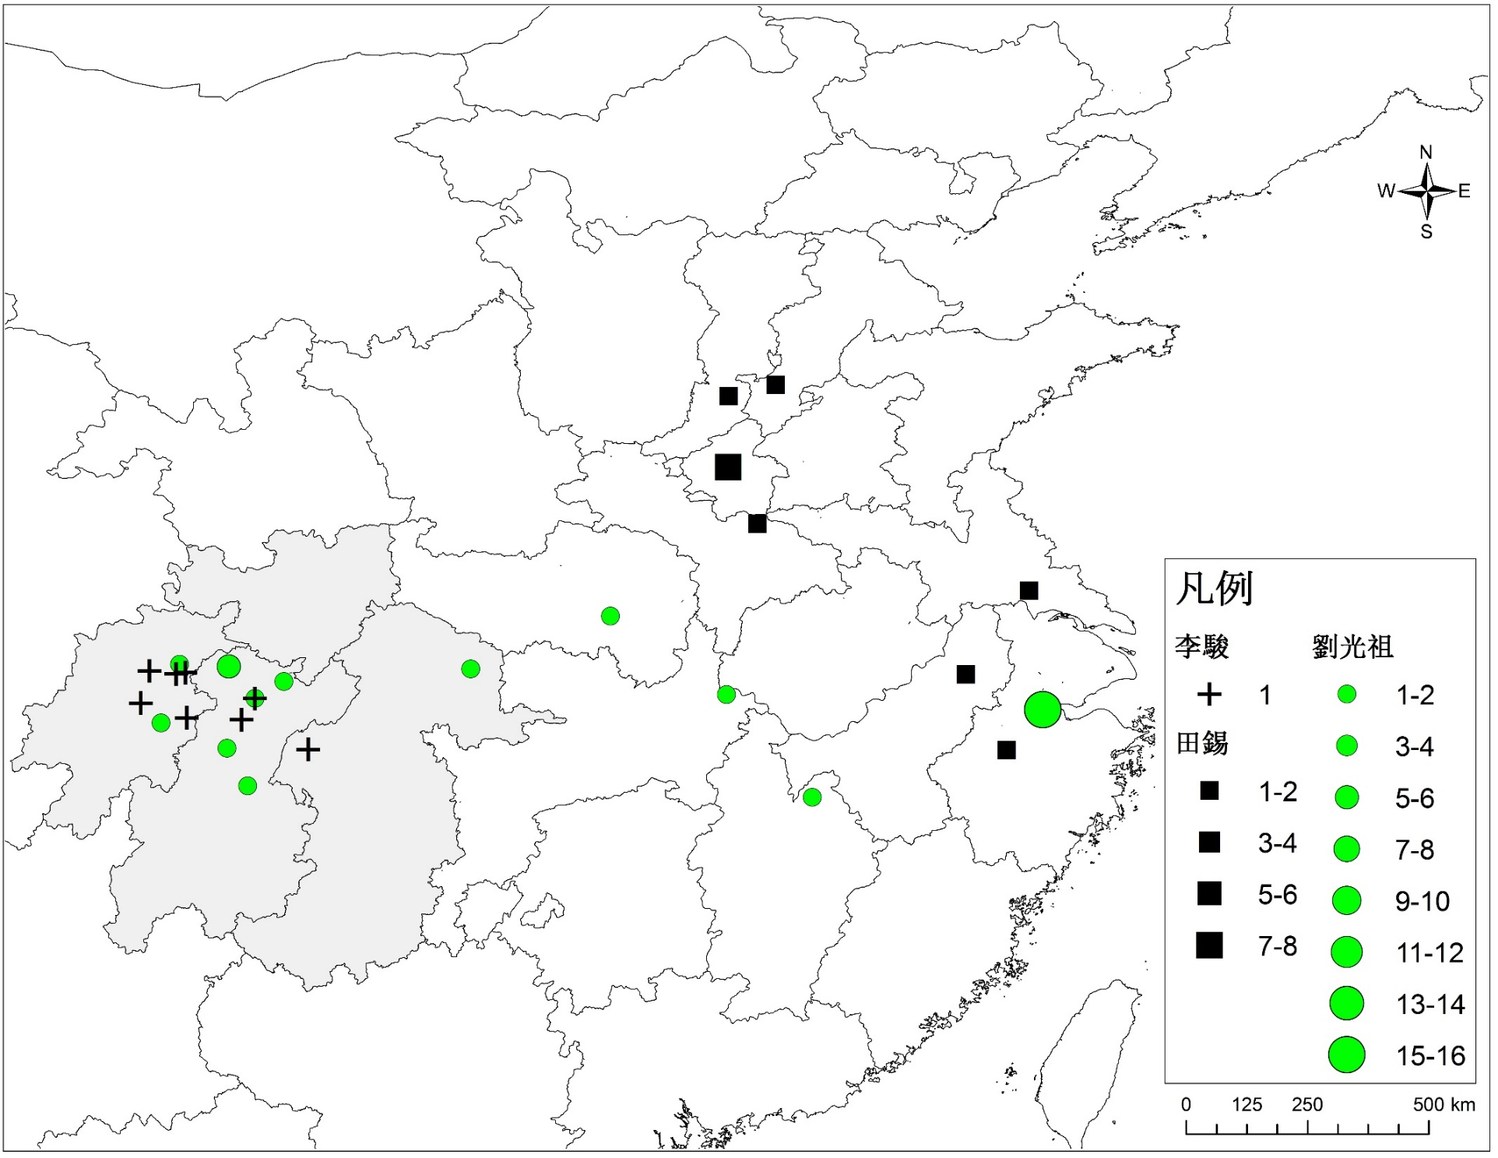

Slide 39
Network Analysis as a Worldview
From individual essences to structure of patterned interrelationships
從每個人物的自身的特質、所屬的社會階層或政治團體 轉向 由各個人物彼此之間的聯繫構建起來的社會結構
From internal forces of individual social actors to empowering/constraining structural forces
從每個歷史行為人自身的內在力量 轉向 社會的結構性因素對個人行動賦予的力量或施加的約束

Slide 40
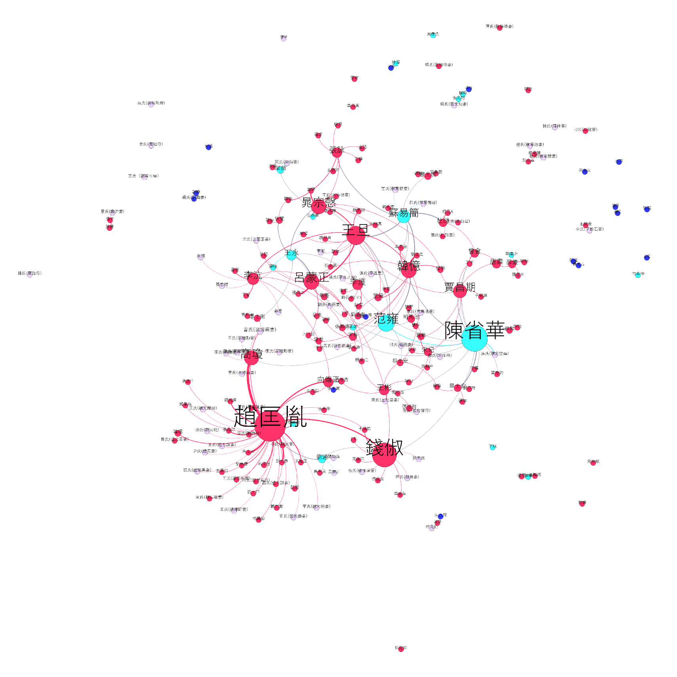
Marriage Networks of Officeholding Descent Groups before 1050
Sichuanese Descent Groups
Sichuanese Emigrants
Non-Sichuanese Families
Regional Origin Unknown
Each node represents a patrilineal descent group, with its size based on betweenness centrality.
Colored by the regional origin of the descent group.

Slide 41
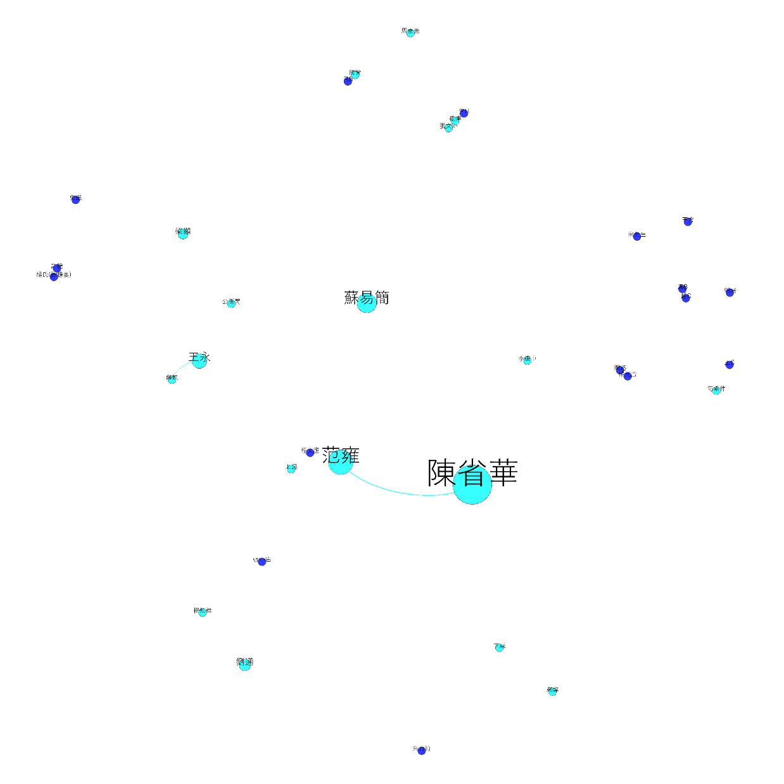
Marriage Networks of Officeholding Descent Groups before 1050
(Sichuan Families Only)
Sichuanese Descent Groups
Sichuanese Emigrants
Each node represents a patrilineal descent group, with its size based on betweenness centrality.
Colored by the regional origin of the descent group.
Notes:
)

Slide 42
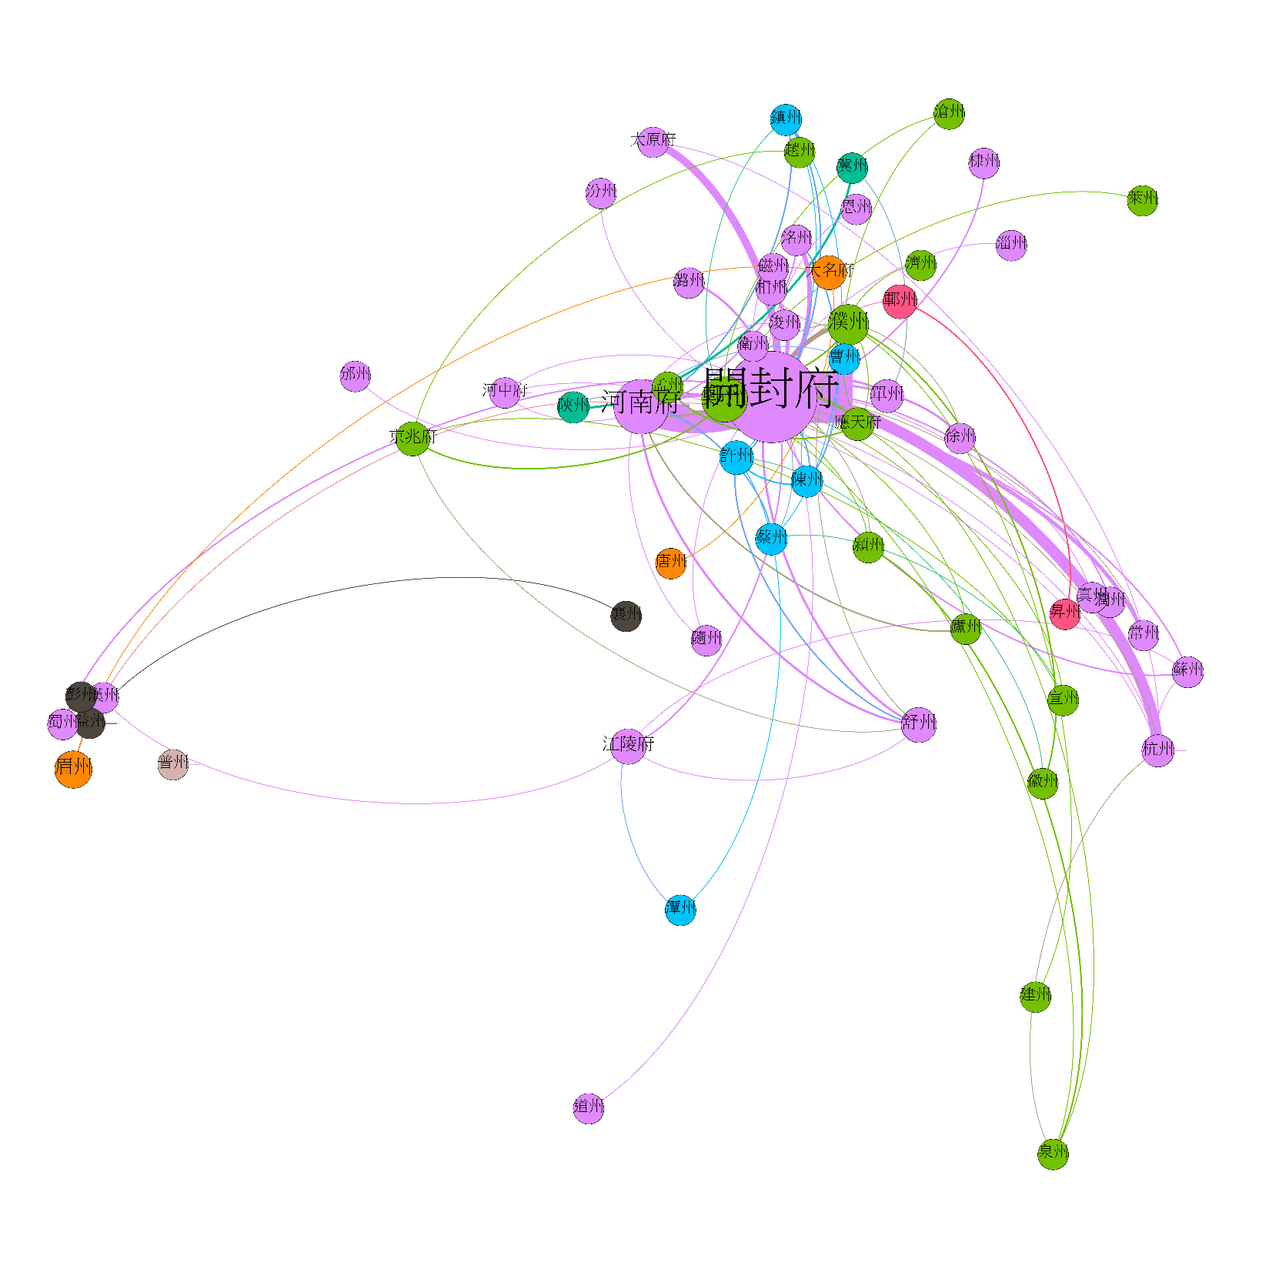
Marriage Networks of Officeholding Descent Groups before 1050
Resolution = 1.0
Each node represents a place of origin., with its size based on betweenness centrality. Colored by modularity class.
Notes:
)

Slide 43
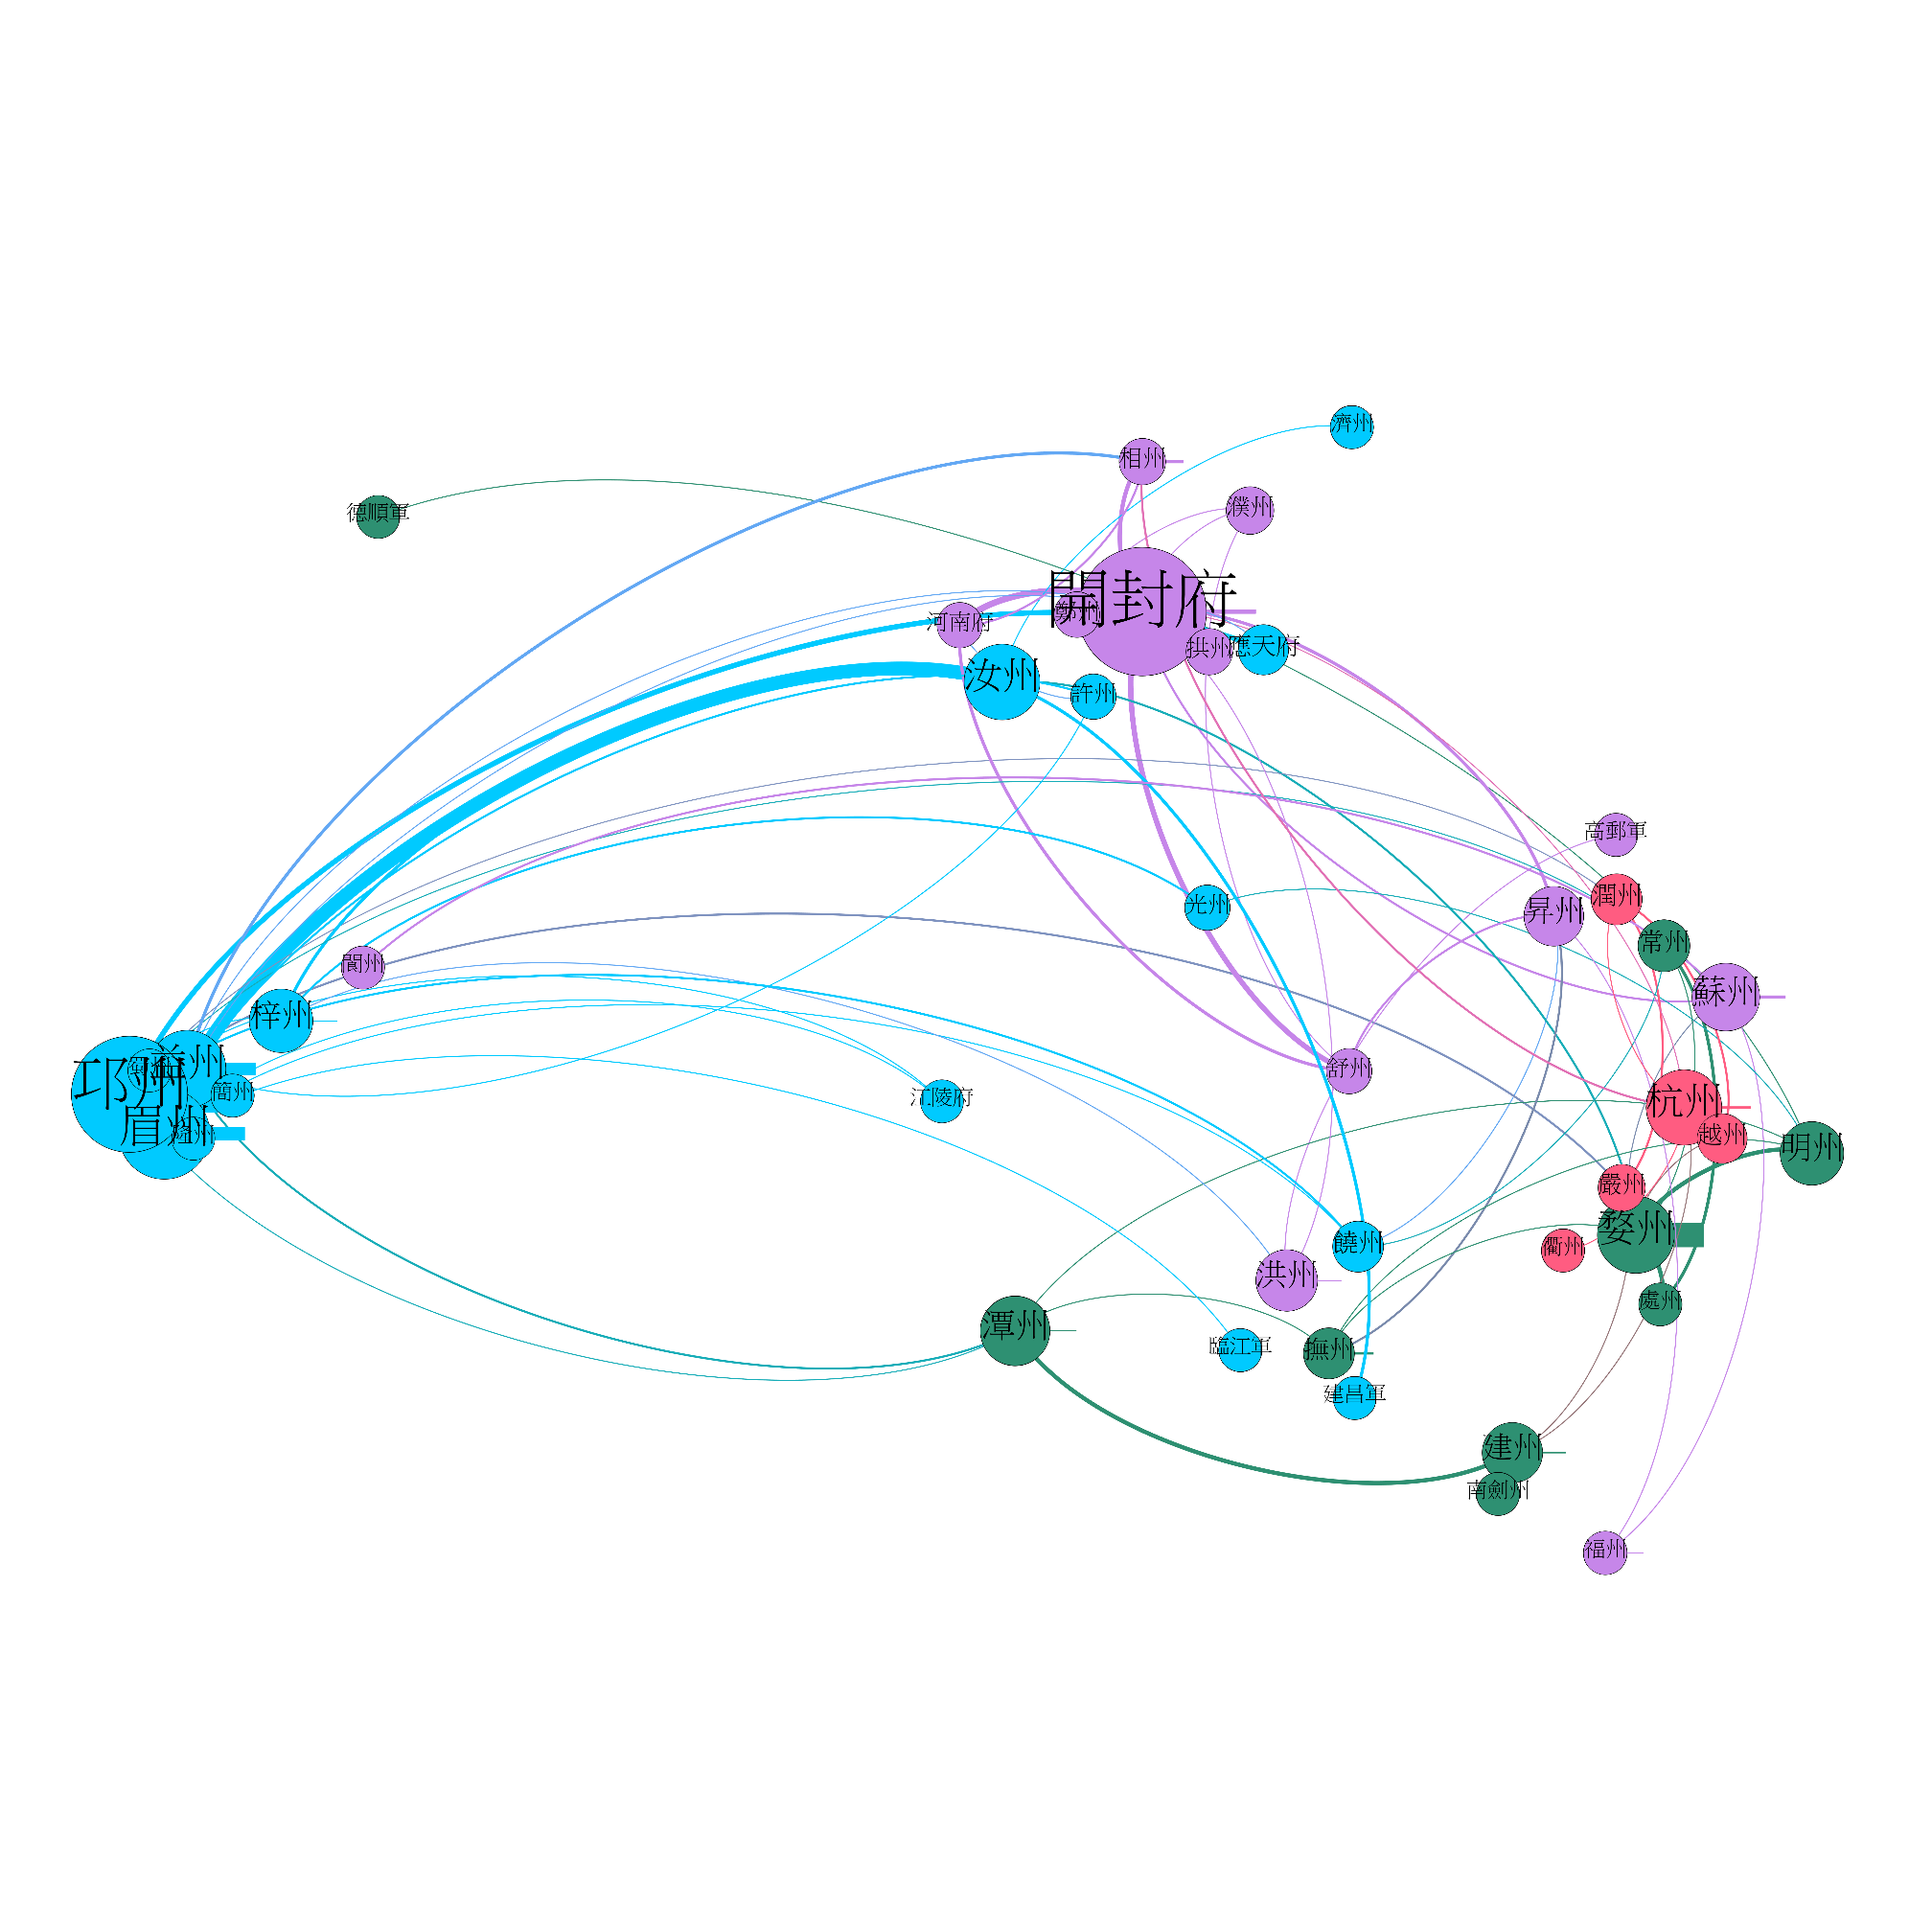
Marriage Networks of Officeholding Descent Groups After 1128
Resolution = 2.0
Each node represents a place of origin., with its size based on betweenness centrality. Colored by modularity class.
Notes:
)

Slide 44
Marriage Networks of Officeholding Families
Sichuan, Song Dynasty
Each node represents a prefecture, positioned according to its longitude and latitude. Size of a node and thickness of a line based on instances of intra- and inter-prefectural marriages documented.

Slide 45
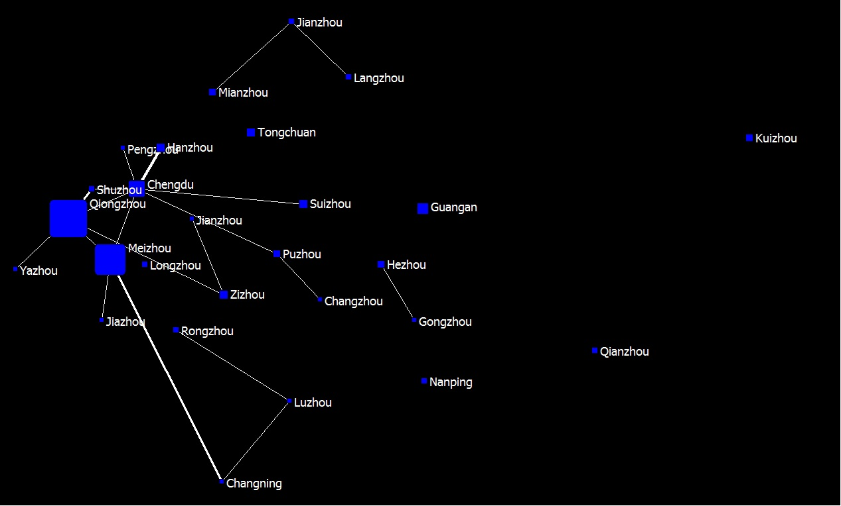
Marriage Networks of Non-Officeholding Families
Sichuan, Song Dynasty
Each node represents a prefecture, positioned according to its longitude and latitude. Size of a node and thickness of a line based on instances of intra- and inter-prefectural marriages documented.

Slide 46
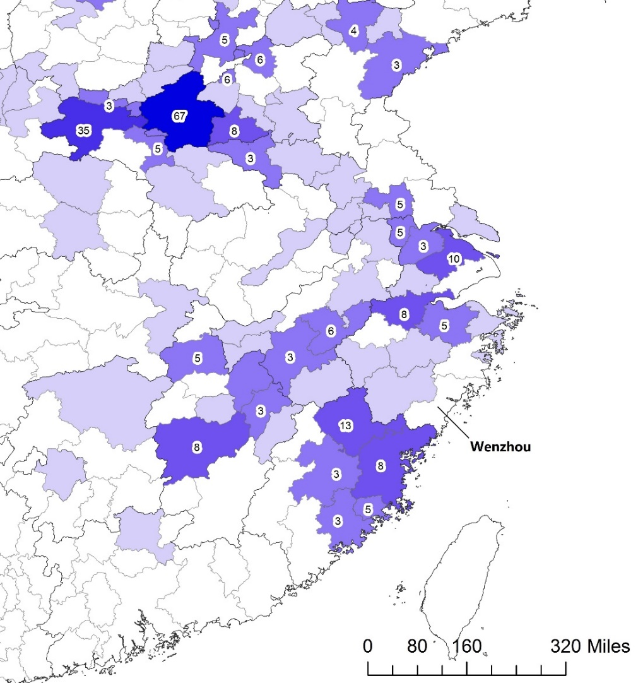
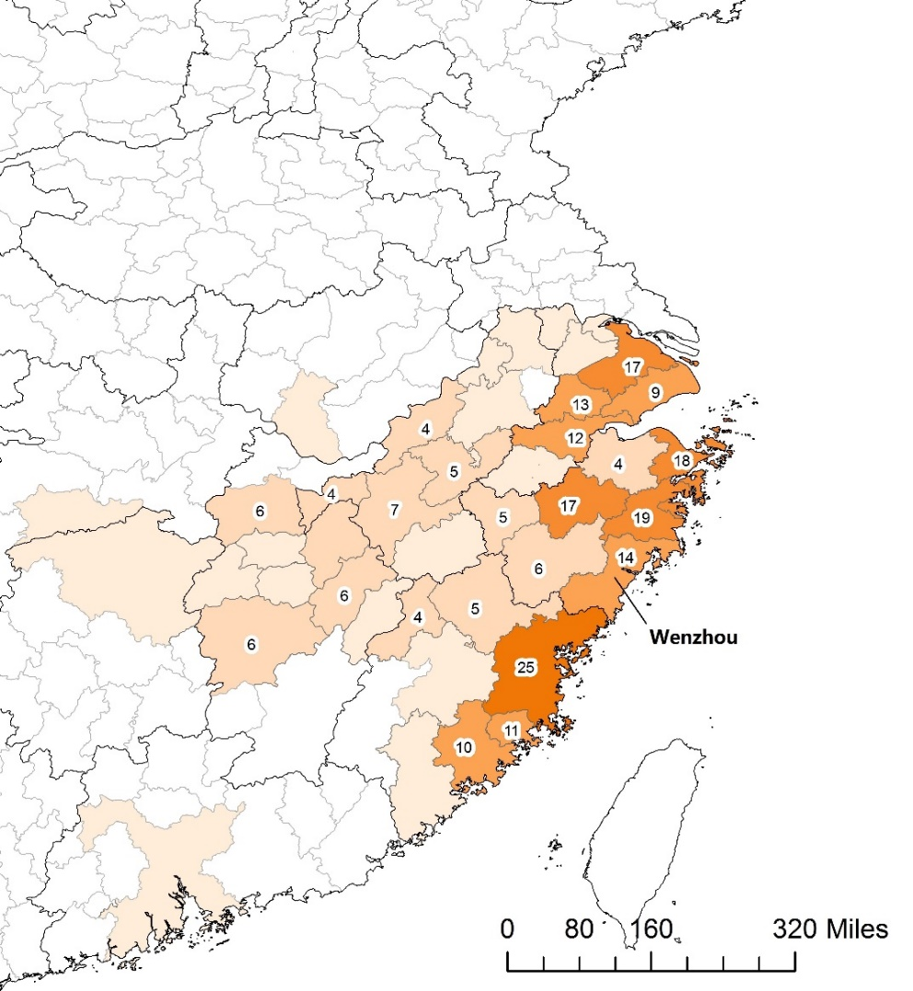
Regional Origins of Prefects, 1040-1049
Regional Origins of Prefects, 1210-1219
Taizhou
Taizhou
Notes:
They show significant differences in the geographical pattern of political success. Obviously, no prefects in the 1210s hailed from the north… which is not surprising, since the Song lost the northern territory to the Jurchens. The remarkable achievements in the 1210s were registered by men from Taizhou and Wenzhou. Taizhou & Wenzhou together: zero (1040s) → 33 (1210s). But the success of the Wenzhou and Taizhou men should be understood not as singular cases, but as part of a much broader change. First of all, the Southern Song capital Hangzhou produced only 4% of the prefects in the 1210s, nothing comparable to Kaifeng. But most importantly in the 1210s was the new geographic pattern of political success. The places that produced the largest number of prefects in the 1210s were almost always coastal prefectures. From Suzhou in the north to Quanzhou in the south, this continuous stretch of ten prefectures along the southeast coast, plus two of their inland neighbors, contributed 61% of the prefects of the 1210s.
Compare this to the map of the 1040s. In the 1040s, political success was not a coastal phenomenon at all. It was a capital phenomenon. Even in the Lower Yangzi, the most successful prefectures were situated along the Grand Canal that provided easy access to the Song capital region. In other words, from the 9C to the 11C and then to the 13C, what we have seen have seen was significant change in the logic of political success – it was less and less about building a powerbase in the capital, but more and more about economic wealth, esp. coastal prosperity.

Slide 47
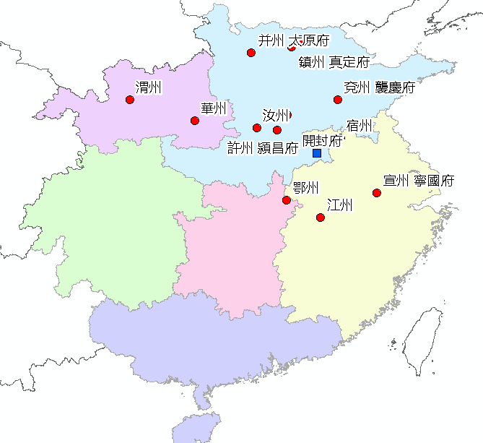
Careers of the 1040s Prefects
Ex: Wang Su 王素 (1007-1073)

Slide 48
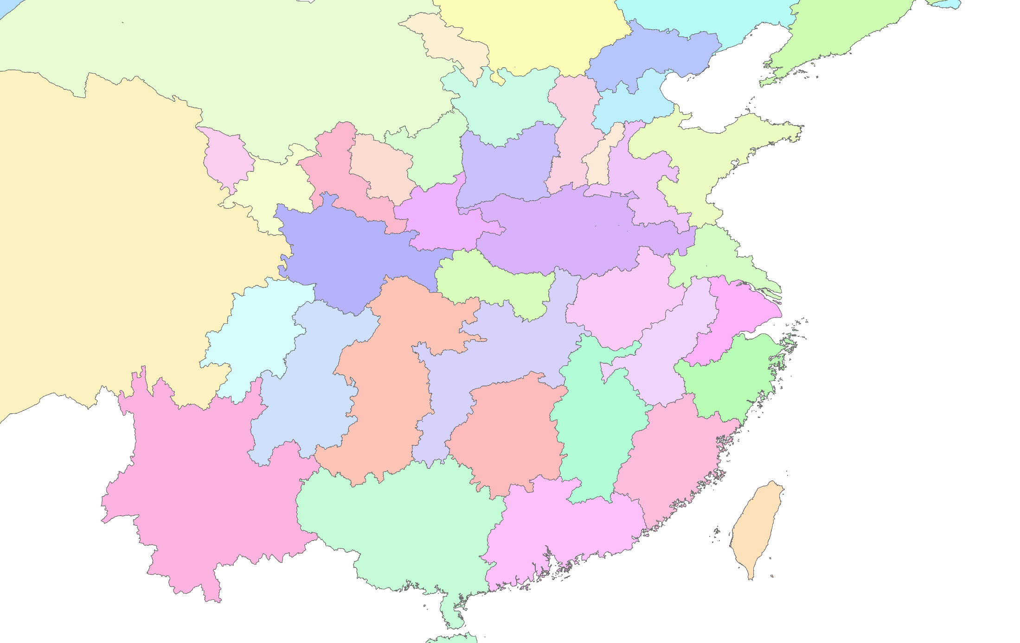
Geographic Patterns of Appointments for the 1210s Cohort
Notes:
Prefects in the 1210s cohort tended to receive the largest proportion of their appointments either inside their home circuit or a neighboring circuit.

Slide 49
Contradistinctions in Appointment to Prefectship
The 1040s: North vs. South
The 1210s: Sichuan vs. South
Notes:
So it shouldn’t surprise us to see that at a very high level of aggregation, what we see in the 1040s was that Northerners served predominantly in the North, and Southerners in the South. In the 1210s, with the loss of northern territory, this north-south contradistinction changed into an east-west contradistinction – that is, Sichuan men served primarily in Sichuan, while men from the Southeast served predominantly in the Southeast.
This suggests a distinctive feature of Song local administration – it recruited men from a much wider region that the capital corridor and employed these new recruits in staffing the offices right in their homelands. This was already noticeable in the 1040s, but back then it was mixed with a tendency of cosmopolitanism that transferred officials across the empire. In the 1210s, the tendency of employing officials locally had become far more pronounced.

Slide 50
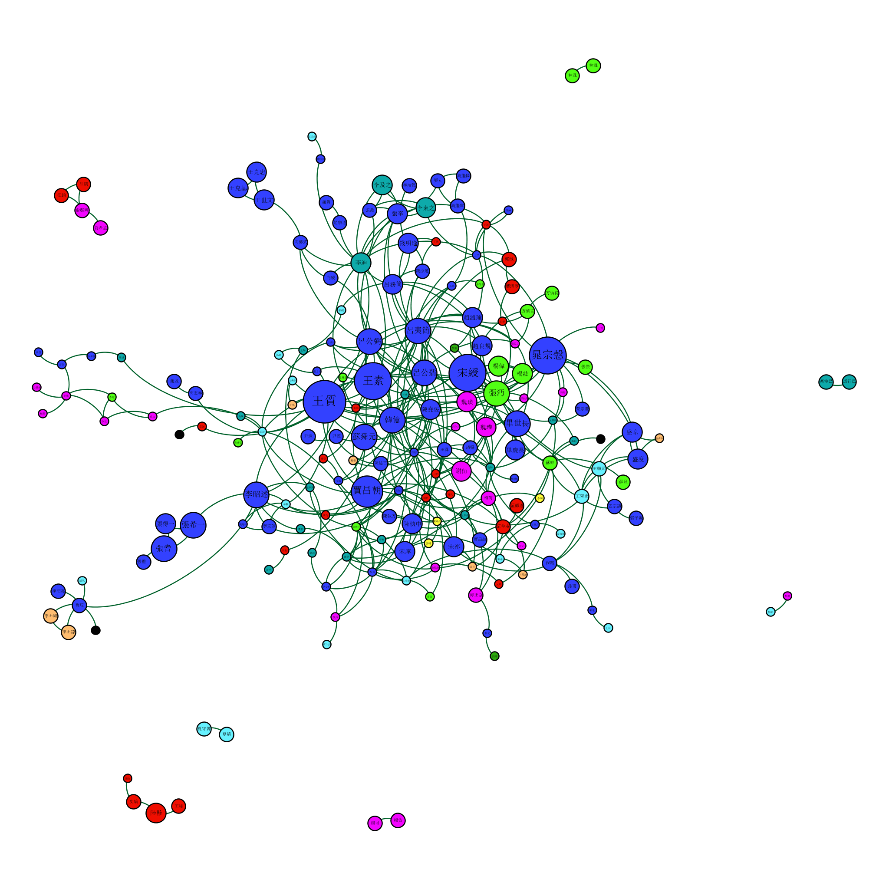
Kinship Relations Among the Prefects, 1040-1049
Node size based on the number of local agnatic and affinal ties.
Colored by regional origin of the prefects.
Notes:
Nodes = person (189); color = biog addr region; size = local ag and direct af connections;
Ties = agnatic and direct affinal relations (368)

Slide 51
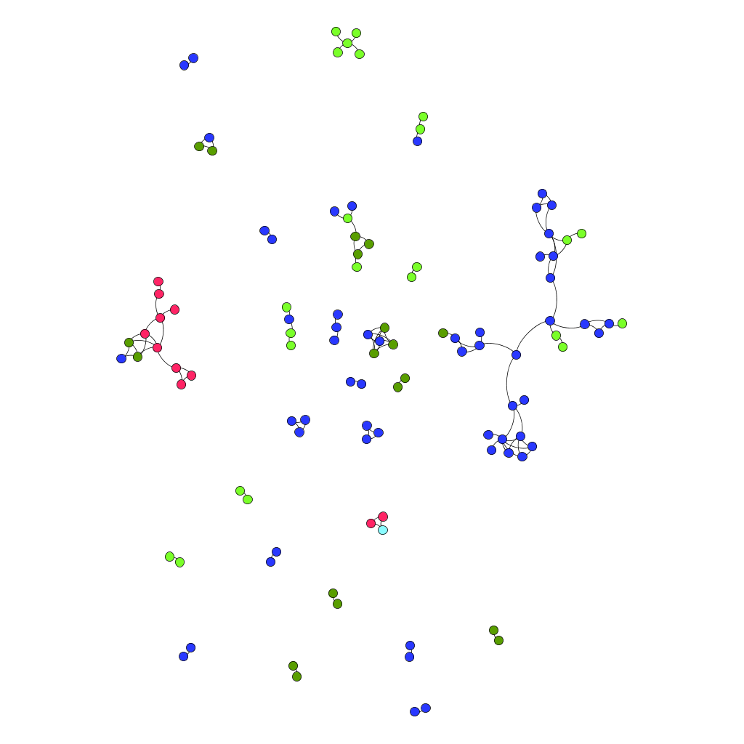
COMPARE TO:
Kinship Relations Among the Prefects, 1210-1219
Sichuan Cluster
Liangzhe-Fujian Cluster
Colored by regional origin of the prefects.
Notes:
Nodes = person; color = biog addr region

Slide 52
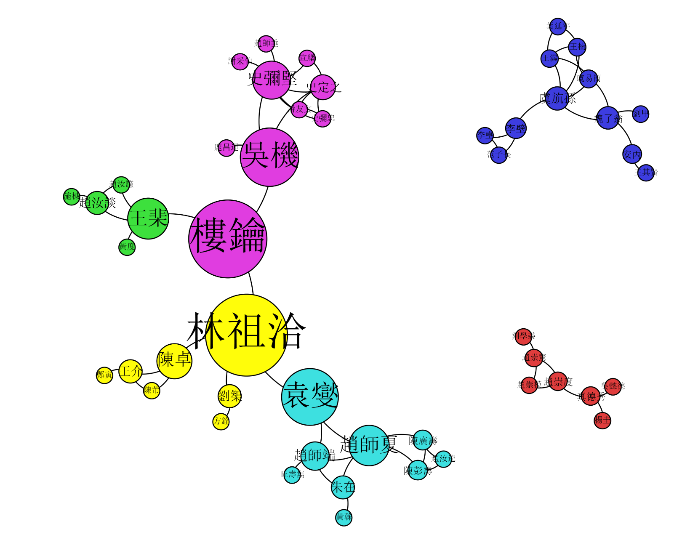
Kinship Relations Among the Prefects, 1210-1219
MODULARITY ANALYSIS
Cluster A: Liangzhe-Fujian Cluster
慶元府
Cluster B: Sichuan Cluster
慶元府
Cluster C
台州
Resolution = 1.0; Number of Communities: 8.
Only the three largest components are shown.
Node size based on betweenness centrality.
Colored by modularity class.
Notes:
Nodes = person; color = modularity communities;
Modularity analysis: res =1, communities = 8
Three largest components only

Slide 53
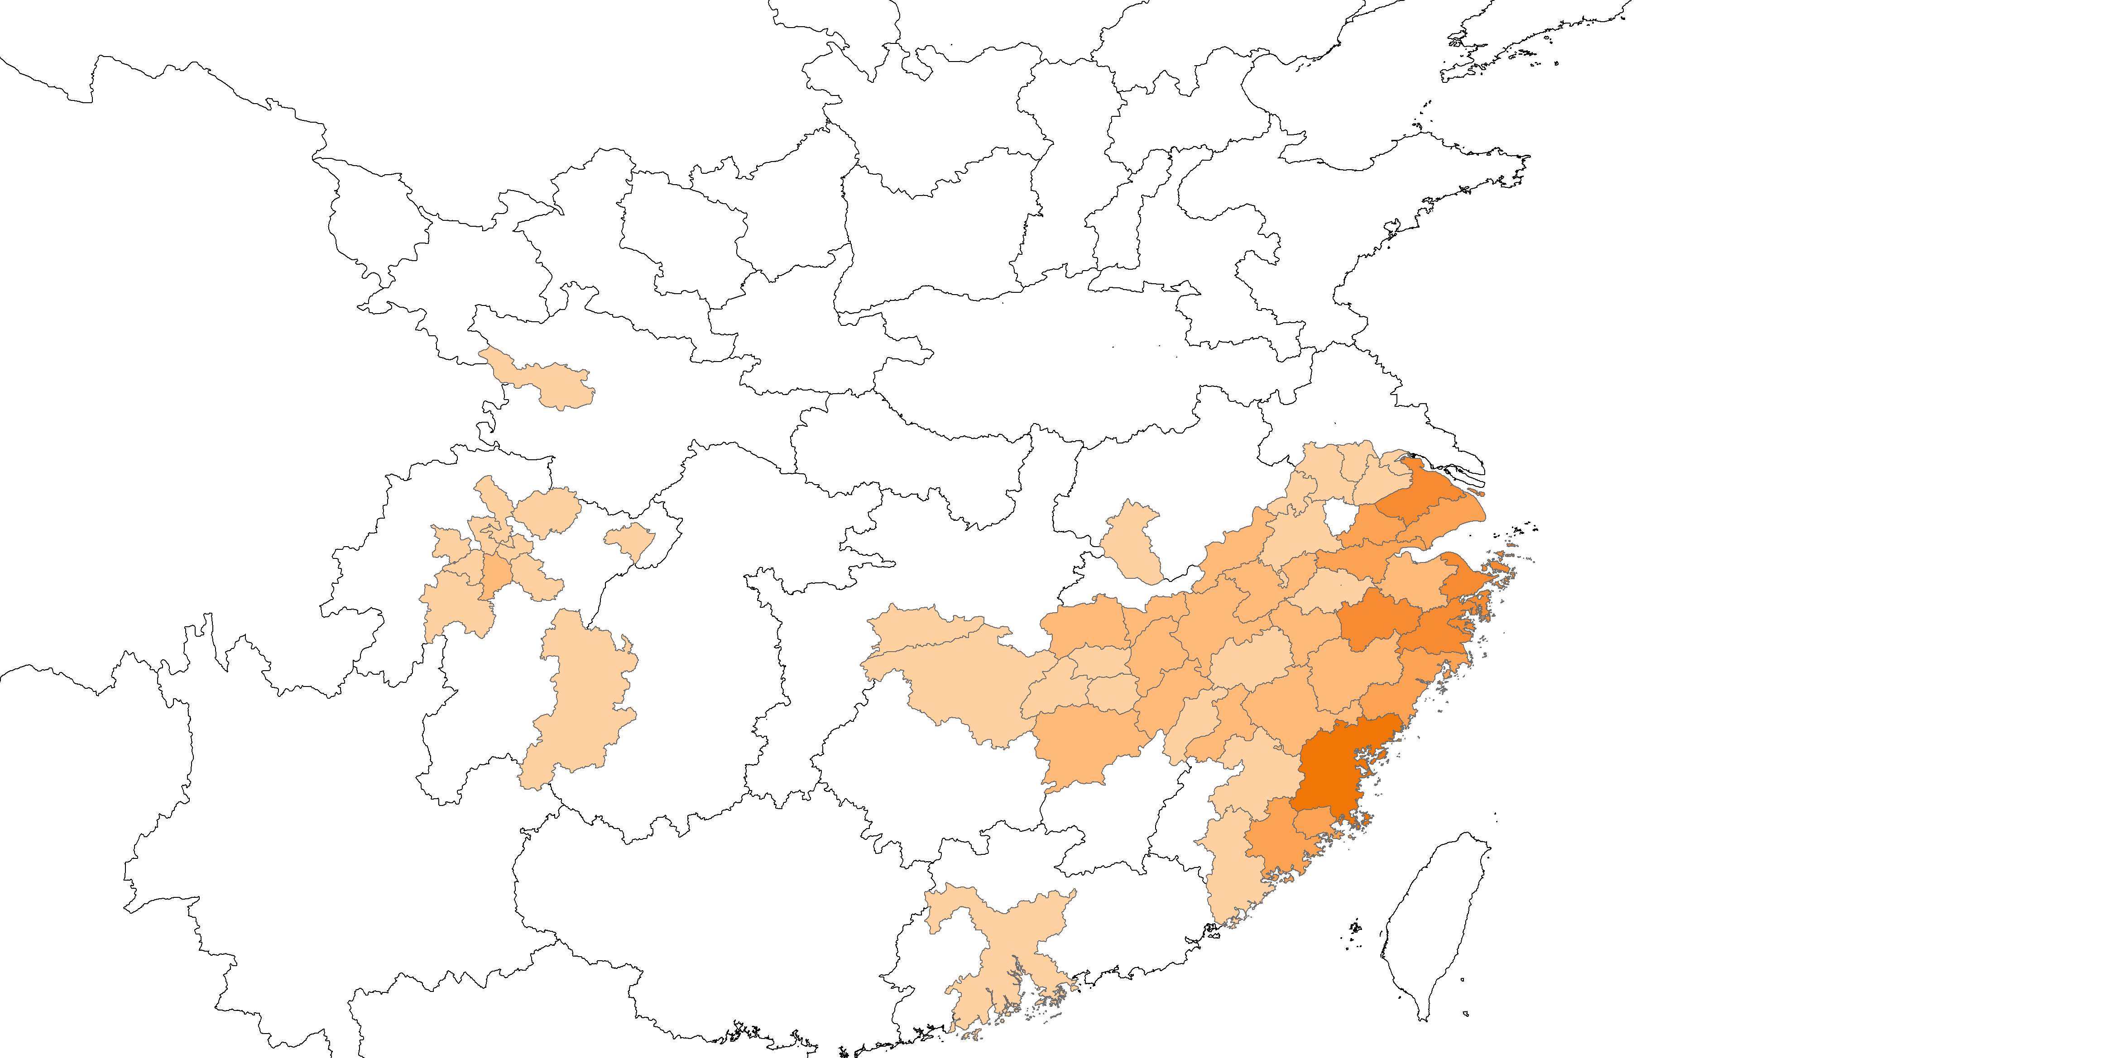
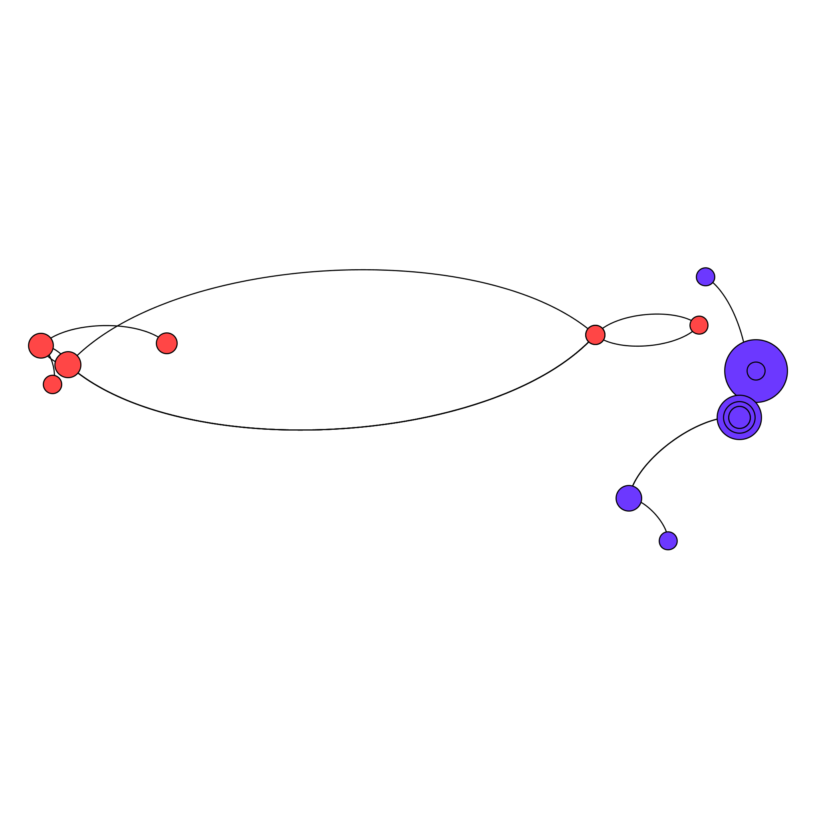
Kinship Relations Among the Prefects, 1210-1219
MODULARITY ANALYSIS
廣安軍
邛州
隆州
饒州
婺州
處州
Cluster B: Sichuan Cluster
建州
Cluster C
Resolution = 1.0; Number of Communities: 8.
Only the three largest components are shown.
Node size based on local agnatic and affinal ties.
Colored by modularity class.
Notes:
Modularity analysis: res = 1;
Nodes = persons; size = local ag and direct af connections; color = module
Module by module to show regional clusters.

Slide 54
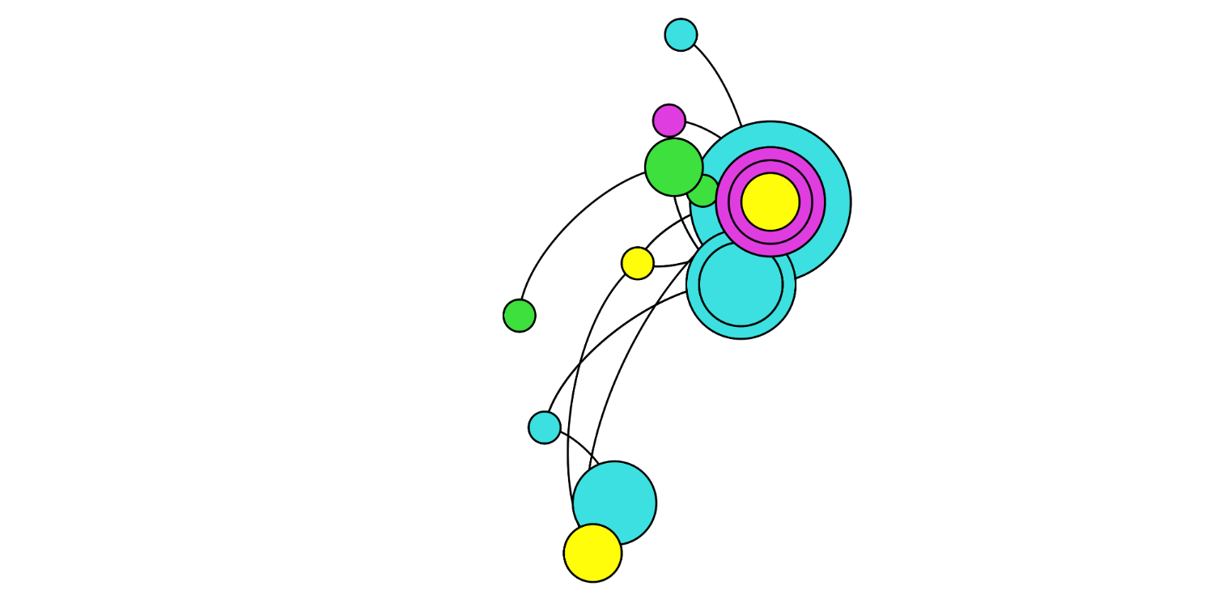
Kinship Relations Among the Prefects, 1210-1219
Spatial Patterns in
The Liangzhe-Fujian Cluster
Cluster A: Liangzhe-Fujian Cluster
慶元府
台州
福州
Resolution = 1.0; Number of Communities in Cluster A: 4.
Only modularity classes in the largest component are shown.
Node size based on local agnatic and affinal ties.
Colored by modularity class.
Notes:
Modularity analysis: res = 1;
Nodes = persons; size = local ag and direct af connections; color = module
Module by module to show regional clusters.

